Slide 1
From Desktop to Exascale: All in on GPUs
Michael A. Heroux
Senior Scientist, Sandia National Laboratories
Former Director of Software Technology, ECP
PI, PESO, Post-ECP Software-Ecosystem Stewardship Project
SIAM Fellow
SIAM Supercomputing Spotlights Series
September 11, 2024

Slide 2
Exascale Computing Project
Maintain international leadership in HPC
Promote the health of the US HPC industry
Deliver a sustainable software ecosystem used and maintained for years to come
Ensure that exascale systems can be used to deliver mission-critical applications
7-year, $1.8B
US Department of Energy project funded 1000+ people at national labs, universities, US industries
This research was supported by the Exascale Computing Project (17-SC-20-SC), a collaborative effort of the U.S. Department of Energy Office of Science and the National Nuclear Security Administration.
Application Development
Develop and enhance the predictive capability of applications, 25 applications, 6 Co-Design Centers
Software Technology
Deliver expanded and vertically integrated software stack, 70 unique products
Hardware and Integration
Application integration and software deployment to facilities, exascale node and system design, 6 US HPC vendors
Notes:
https://exascaleproject.org

Slide 3

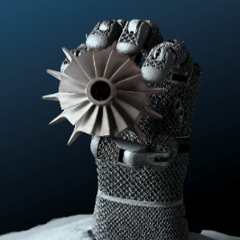
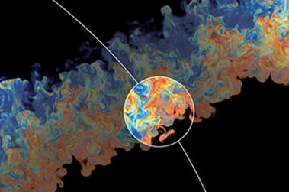
ECP Application Development
National security
Energy security
Economic security
Scientific discovery
Earth system
Health care
Next-generation, stockpile stewardship codes
Reentry-vehicle- environment simulation
Multi-physics science simulations of high-energy density physics conditions
Turbine wind plant efficiency
Design and commercialization of SMRs
Nuclear fission and fusion reactor materials design
Subsurface use for carbon capture, petroleum extraction, waste disposal
High-efficiency, low-emission combustion engine and gas turbine design
Scale up of clean fossil fuel combustion
Biofuel catalyst design
Additive manufacturing of qualifiable metal parts
Reliable and efficient planning of the power grid
Seismic hazard risk assessment
Cosmological probe of the standard model of particle physics
Validate fundamental laws of nature
Plasma wakefield accelerator design
Light source-enabled analysis of protein and molecular structure and design
Find, predict, and control materials and properties
Predict and control magnetically confined fusion plasmas
Demystify origin of chemical elements
Accurate regional impact assessments in Earth system models
Stress-resistant crop analysis and catalytic conversion of biomass-derived alcohols
Metagenomics for analysis of biogeochemical cycles, climate change, environmental remediation
Accelerate and translate cancer research (partnership with NIH)
The 24 AD application projects
Include 62 separate codes
Represent over 10 million lines of code
In some cases support large user communities
Mostly started with MPI or MPI+OpenMP on CPUs
Architecture-
specific
optimization
Manycore
CPU
CPU+
GPU
CPU+
Multi-GPU
GPU
Resident
Diverse
Multi-GPU

Slide 4
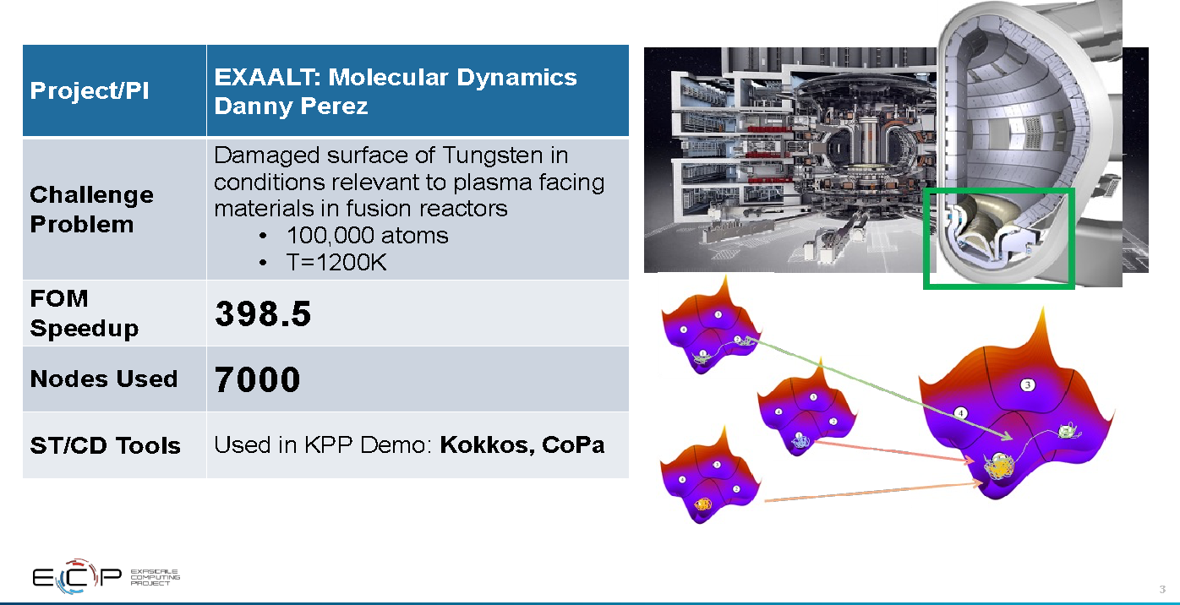
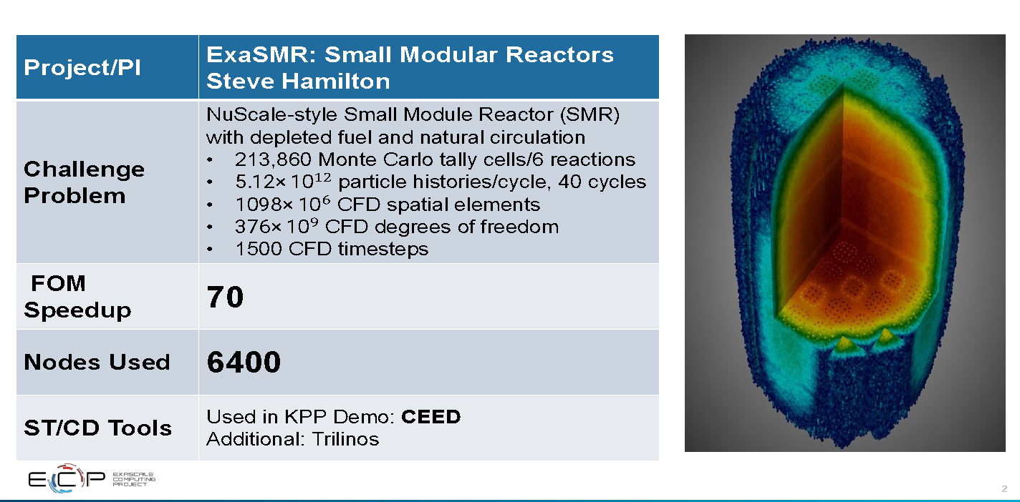
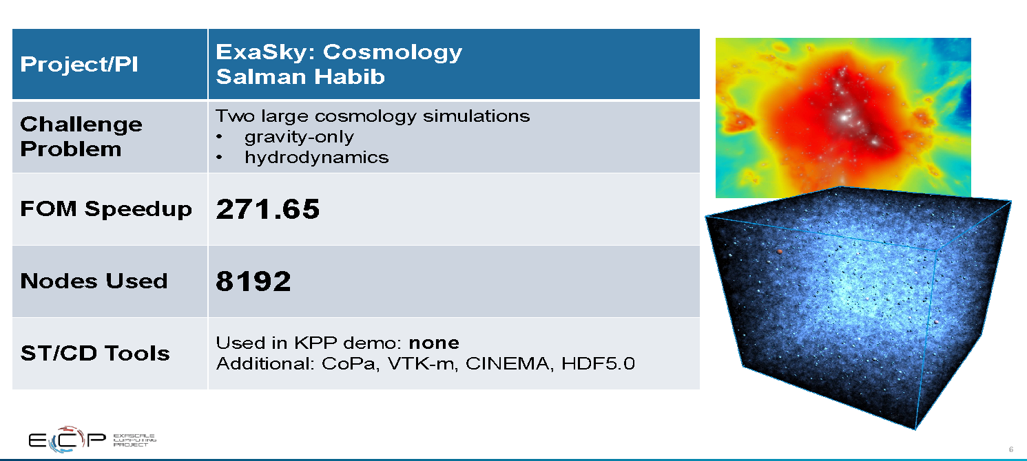
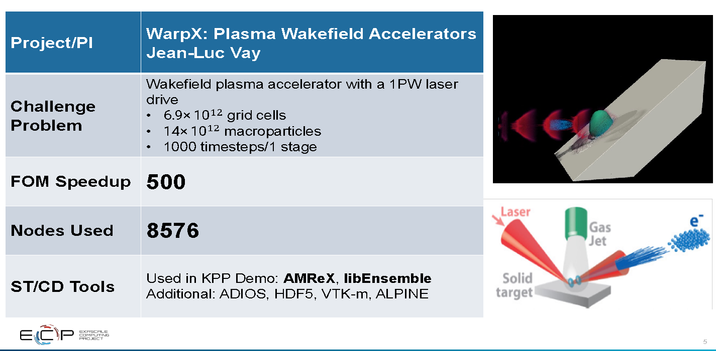
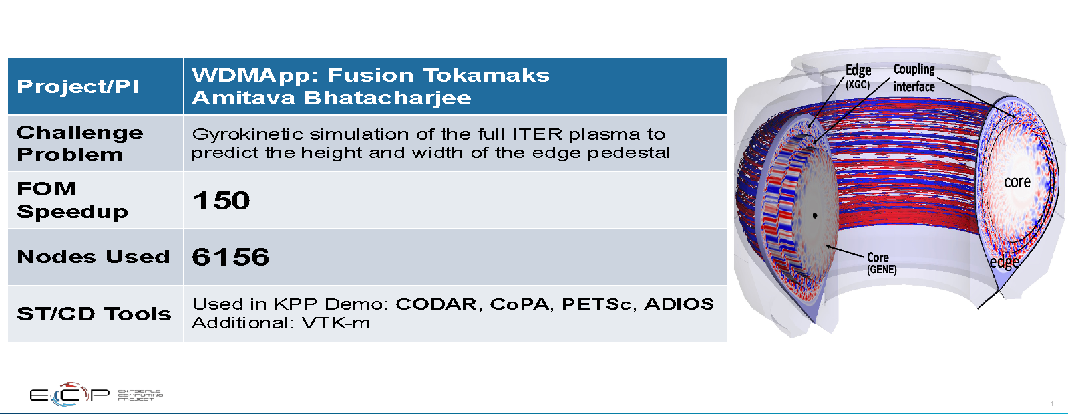
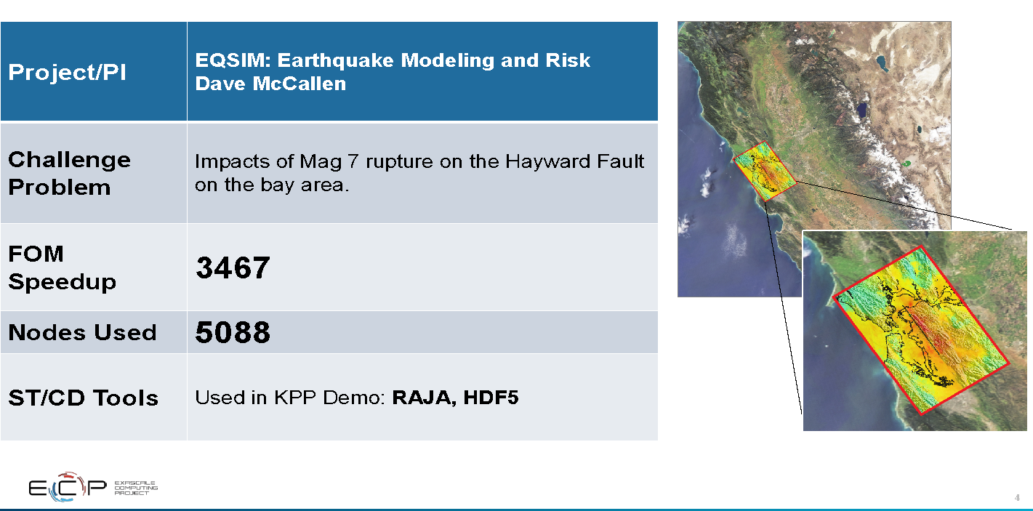

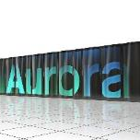
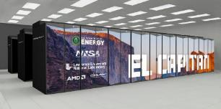
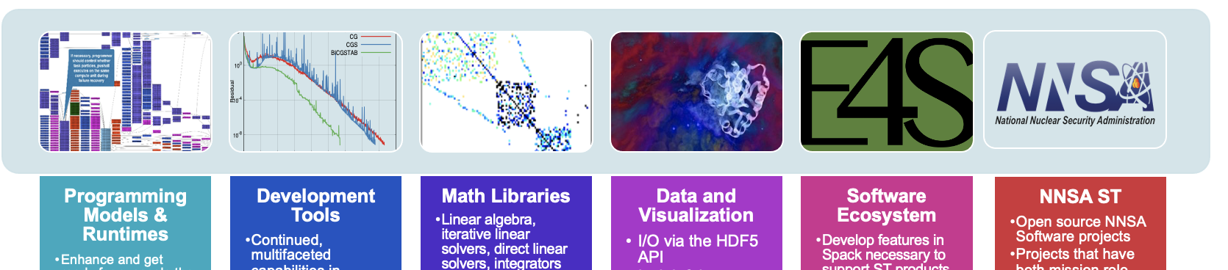
ECP libraries and tools supported diverse applications across multiple architectures
ORNL Frontier HPE/AMD
ECP Software Technologies
ANL Aurora Intel/HPE
Prepare SW stack for scalability with massive on-node parallelism
70 software products across 6 technical areas
LLNL El Capitan HPE/AMD
Extend existing capabilities when possible, develop new when not
Guide, and complement, and integrate with vendor efforts
Develop and deliver high-quality and robust software products
4

Slide 5
ECP Impact – Portable Libraries and Tools for Accelerators

Slide 6
ECP ST six technical areas
Programming Models & Runtimes
Enhance and get ready for exascale the widely used MPI and OpenMP programming models (hybrid programming models, deep memory copies)
Development of performance portability tools (e.g. Kokkos and Raja)
Support alternate models for potential benefits and risk mitigation: PGAS (UPC++/GASNet) ,task-based models (Legion, PaRSEC)
Libraries for deep memory hierarchy and power management
Development Tools
Continued, multifaceted capabilities in portable, open-source LLVM compiler ecosystem to support expected ECP architectures, including support for F18
Performance analysis tools that accommodate new architectures, programming models, e.g., PAPI, Tau
Math Libraries
Linear algebra, iterative linear solvers, direct linear solvers, integrators and nonlinear solvers, optimization, FFTs, etc
Performance on new node architectures; extreme strong scalability
Advanced algorithms for multi-physics, multiscale simulation and outer-loop analysis
Increasing quality, interoperability, complementarity of math libraries
Data and Visualization
I/O via the HDF5 API
Insightful, memory-efficient in-situ visualization and analysis – Data reduction via scientific data compression
Checkpoint restart
Software Ecosystem
Develop features in Spack necessary to support all ST products in E4S, and the AD projects that adopt it
Development of Spack stacks for reproducible turnkey deployment of large collections of software
Regular E4S releases of the ST software stack and SDKs with regular integration of new ST products
Optimization and interoperability of containers on HPC systems
NNSA ST
Open source NNSA Software projects
Projects that have both mission role and open science role
Cover most ST technology areas
Subject to the same planning, reporting and review processes
Major technical areas: New programming abstractions, math libraries, data and viz libraries
6
Notes:
Open MP
Identified that one of the most important gaps in OpenMP is how to program the different memories available in the node and how to map to/from complex data structures between them that require deep copy
Gathered application use cases from E3SM, QMCPack, XGC, LSMS3, LAMMPS, GENESIS, etc. Used this information to drive the memory management API, declare mappers and manual deep copy functionality in OpenMP 5.0.
Developed test cases to implement manual deep copy, declare mappers and the new memory management API in OpenMP 5.0.
A SOLLVE software release was made publicly available on GitHub at https://github.com/SOLLVE/sollve. Enhancements include: 1) better performance for OpenMP nested parallel regions using BOLT lightweight threading, 2) improvements that facilitate optimization of OpenMP outlined functions, 3) initial support for OpenMP 5.0 declare mapper to enable accelerator deep copy, 4) pragmas to succinctly direct advanced loop transformations, and 5) an OpenMP offloading validation & verification suite, that allows users and vendors to validate OpenMP implementations.
Exa-PAPI builds on the latest PAPI project and we are extending it with:
Effort 1: Performance counter monitoring capabilities for new and advanced ECP hardware, and software technologies.
Effort 2: Fine-grained power management support.
Effort 3: Functionality for performance counter analysis at "task granularity" for task-based runtime systems.
Effort 4: "Software-defined Events" that originate from the ECP software stack and are currently treated as black boxes (i.e., communication libraries, math libraries, task-based runtime systems, etc.)
Co-Design of a new standard API for SDEs with libraries and runtime communities. (FY18)
Implement infrastructure for SDE support in Exa-PAPI. (FY18 + FY19)
STRUMPACK
Better OpenMP support in HSS compression, HSS factorization and HSS matvec.
Use OpenMP tasking parallelism, e.g. taskloop
Improved threading in element extraction, ULV factorization
Threading improvements in sparse-matrix randomized sampling.
Results:
Dense matrix HSS compression is up to 4.7x faster on 8 nodes (256 cores) of Cori-Haswell and 2.4x faster on Cori-NKL.
The HSS embedded sparse factorization, is up to 2.2x faster on 8 KNL nodes.
By fixing a memory bottleneck, we can now compress much larger HSS matrices.
zfp: compressed format for error-controlled reduction in I/O and storage
In-memory compressed storage of tables & viz data with prescribed footprint
Capacity limited apps & in situ, in transit, and post hoc viz are enabled by compressed arrays
Bandwidth reduction for CPU ⟺ GPU, node-to-node communication, I/O
Error-bounded data reduction for checkpoint & viz file storage
Massively data-parallel (de)compression via block decomposition
zfp is ideally positioned to exploit manycore architectures
More accurate representation than IEEE
Same accuracy at half the storage or less
Orders of magnitude more accurate using same storage
Team members developed popular, open source tools (ParaView, VisIt) based on the Visualization ToolKit library (VTK)
Widespread usage in DOE and >1 million downloads worldwide
Hundreds of person years of effort
Major visualization and analysis problems for exascale:
Many-core architectures
I/O limitations will require data reduction/ in situ processing
Artifacts created will require new methods of analysis and visualization

Slide 7
ECP-sponsored Software Products: A Sample

Slide 8
Programming Models & Runtimes
GPU-specific kernels
Isolate the computationally-intensive parts of the code into CUDA/HIP/SYCL kernels.
Refactoring the code to work well with the GPU is the majority of effort.
Loop pragma models
Offload loops to GPU with OpenMP or OpenACC.
Most common portability strategy for Fortran codes.
Four Parallel Node Programming Approaches
C++ abstractions
Fully abstract loop execution and data management using advanced C++ features.
Kokkos and RAJA developed by NNSA in response to increasing hardware diversity.
Co-design frameworks
Design application with a specific motif to use common software components
Depend on co-design code (e.g. CEED, AMReX) to implement key functions on GPU.

Slide 9
Efficiently utilizing GPUs goes far beyond typical code porting
Port Code
Adapt Numerics
Adapt Models
Rewrite, profile, and optimize
Memory coalescing
Loop ordering
Kernel flattening
Reduced synchronization
Reduced precision
Communication avoiding
Mathematical representation
“On the fly” recomputing vs. lookup tables
Prioritization of new physical models
ECP efforts have de-risked (but not removed) these activities for others

Slide 10
DOE Exascale Computing Project
17 Codes list Fortran as critical
Some of those actually moved on
Not all of those run on GPUs
CUDA Fortran, OpenMP, OpenACC
Large Majority of C++ Codes Chose Abstraction over Vendor Models!

Slide 11
Kokkos Programming Model

Slide 12


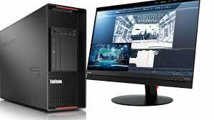
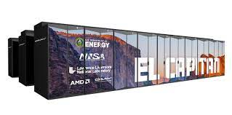
What is Kokkos?
A C++ Programming Model for Performance Portability
Implemented as a template library on top of CUDA, OpenMP, HIP, SYCL, …
Aims to be descriptive not prescriptive
Aligns with developments in the C++ standard
Replaces usage of CUDA, OpenMP, HIP, etc.
Expanding solution for common needs of modern science/engineering codes
Math libraries based on Kokkos
Tools which enable insight into Kokkos
It is Open Source
Maintained and developed at https://github.com/kokkos
It has many users at wide range of institutions.
Kokkos is NOT just for GPUs!

Slide 13
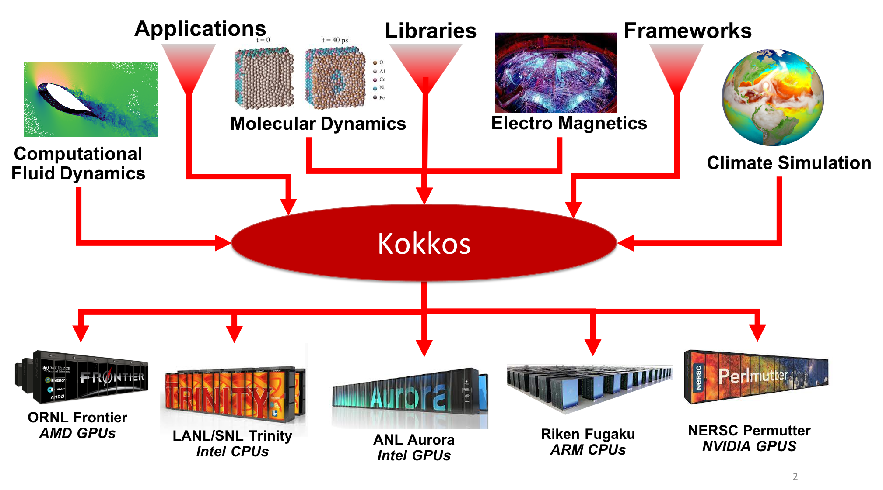

Slide 14
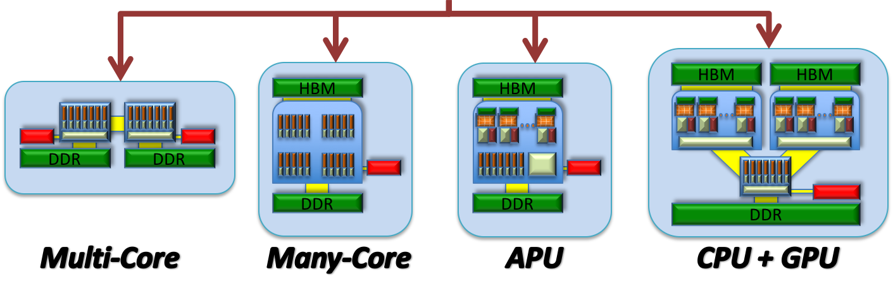
The Kokkos Ecosystem
Science and Engineering Applications
Kokkos Tools
Kokkos Support
Documentation
Kokkos EcoSystem
Debugging
Tutorials
Kokkos Kernels
Profiling
Linear Algebra Kernels
Graph Kernels
Bootcamps
App support
Tuning
Kokkos Core
Parallel Execution
Parallel Data Structures
Kokkos Remote Spaces
Trilinos
PETSc
Resilience
Global Arrays
PDE Solvers/Data Str.
Data Snapshot
Distributed LA, Solvers, MultiGrid, UQ, AD, Discretization, Time Integration
ArborX
Redundant Execution
PyKokkos
Geometric Search
Python Bindings
Cabana
Fortran Interop
Python Programming
Particle Sim Toolkit
View Bindings

Slide 15
Kokkos Core Abstractions
Kokkos
Data Structures
Parallel Execution
Memory Spaces (“Where”)
Execution Spaces (“Where”)
- HBM, DDR, Non-Volatile, Scratch
- CPU, GPU, Executor Mechanism
Memory Layouts
Execution Patterns
- Row/Column-Major, Tiled, Strided
- parallel_for/reduce/scan, task-spawn
Memory Traits (“How”)
Execution Policies (“How”)
- Streaming, Atomic, Restrict
- Range, Team, Task-Graph

Slide 16
CG Solve: The AXPBY
Simple data parallel loop: Kokkos::parallel_for
Easy to express in most programming models
Bandwidth bound
Serial Implementation:
Kokkos Implementation:
void axpby(int n, double* z, double alpha, const double* x,
double beta, const double* y) {
for(int i=0; i<n; i++)
z[i] = alpha*x[i] + beta*y[i];
}
String Label: Profiling/Debugging
Execution Policy: do n iterations
Parallel Pattern: for loop
Loop Body
Iteration handle: integer index
void axpby(int n, View<double*> z, double alpha, View<const double*> x,
double beta, View<const double*> y) {
parallel_for("AXpBY", n, KOKKOS_LAMBDA ( const int i) {
z(i) = alpha*x(i) + beta*y(i);
});
}

Slide 17
Kokkos Support
The Kokkos Lectures
8 lectures covering most aspects of Kokkos
15 hours of recordings
> 500 slides
>20 exercises
Extensive Wiki
API Reference
Programming Guide
Slack as primary direct support
https://kokkos.link/the-lectures
Module 1: Introduction
Introduction, Basic Parallelism, Build System
Module 2: Views and Spaces
Execution and Memory Spaces, Data Layout
Module 3: Data Structures and MDRangePolicy
Tightly Nested Loops, Subviews, ScatterView,…
Module 4: Hierarchical Parallelism
Nested Parallelism, Scratch Pads, Unique Token
Module 5: Advanced Optimizations
Streams, Tasking and SIMD
Module 6: Language Interoperability
Fortran, Python, MPI and PGAS
Module 7: Tools
Profiling, Tuning , Debugging, Static Analysis
Module 8: Kokkos Kernels
Dense LA, Sparse LA, Solvers, Graph Kernels

Slide 18
Kokkos Kernels
BLAS, Sparse and Graph Kernels on top of Kokkos and its View abstraction
Scalar type agnostic, e.g. works for any types with math operators
Layout and Memory Space aware
Can call vendor libraries when available
Views contain size and stride information => Interface is simpler
// BLAS
int M, N, K, LDA, LDB; double alpha, beta; double *A, *B, *C;
dgemm('N','N’, M, N, K, alpha, A, LDA, B, LDB, beta, C, LDC);
vs.
// Kokkos Kernels
double alpha, beta; View<double**> A,B,C;
gemm('N','N’, alpha, A, B, beta, C);

Slide 19
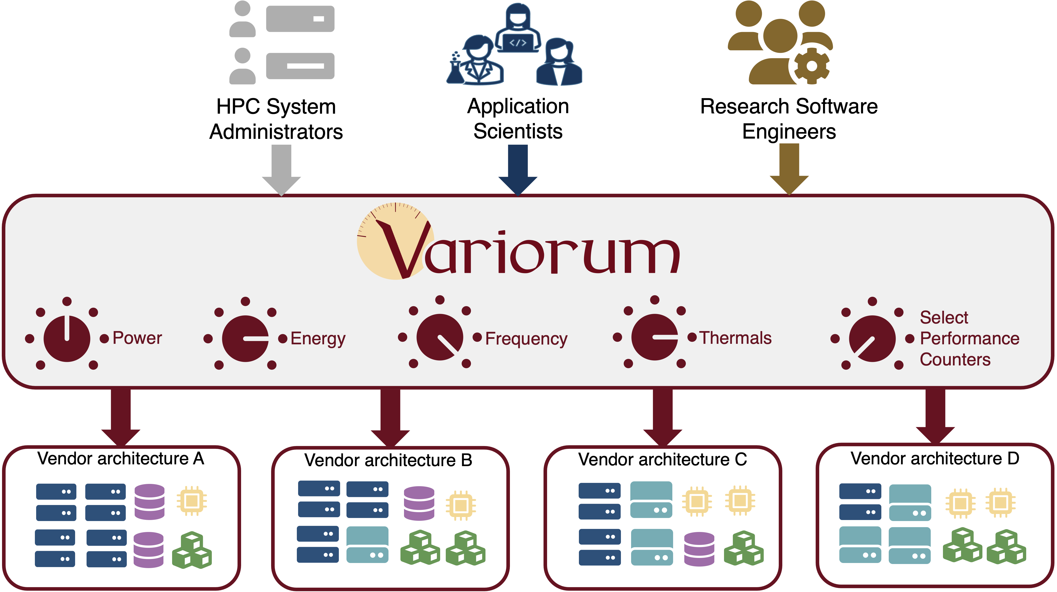
Variorum provides safe, user-space, vendor neutral access for all users: administrators, application scientists and RSEs
Development Tools
PI: Tapasya Patki Team: Kathleen Shoga, Stephanie Brink, Eric Green, Aniruddha Marathe, Barry Rountree

Slide 20
Variorum: Vendor-neutral user space library for power management
Power management capabilities (and their interfaces, domains, latency, capabilities) widely differ from one vendor to the next, needing common interfaces
Variorum: Platform-agnostic vendor-neutral, simple front-facing APIs
Evolved from libmsr, and designed to target several platforms and architectures
Abstract away tedious and chaotic details of low-level knobs
Implemented in C, with function pointers to specific target architecture
Integration with higher-level power management software through JSON
Integrated with Flux, GEOPM, LDMS, Kokkos, Caliper and PowerAPI to enable a PowerStack
Supported on all upcoming exascale systems (Aurora, Frontier, El Capitan) and several other supercomputers: architecture support includes CPU support for ARM, AMD, Intel, IBM; and GPU support for NVIDIA, AMD and Intel.
Notes:
As we move towards exascale and more heterogeneous nodes, trying to develop APIs to expose the individual feature implementations across the different devices is a complex space (see bottom right figure). Instead of having to expose an interface for each device and each feature, we propose Variorum, which will provide device-agnostic APIs to expose the underlying features (advance to next slide). Additionally, our goals with Variorum are to (1) provide APIs that target the 95% of users who are not aware of the underlying hardware architecture that their application is running on, (2) add support for additional devices, such as other CPU vendors, accelerators, and PCIe devices like integrated memory controller and interconnects, (3) add support for multiple generations within a single device, and (4) expose additional hardware knobs and controls.
Variorum is a vendor-neutral user space library for power management. It provides platform-agnostic easy-to-use front-facing APIs. One of the optimizations we have in Variorum, is to batch many operations together to minimize the overhead of executing many monitoring/control operations (i.e, read/write). There is a time penalty occurred for each read/write operation; batching many operations together means that you pay the penalty 1 time. Variorum is a production version of libmsr, so all the functionality that currently exists in libmsr will be migrated. This is a C-based library and we use function pointers to set the particular implementation for the given architecture.
The right figure shows a high-level overview of Variorum’s architecture. Currently, Variorum supports Intel and IBM platforms. On the roadmap will be to target NVIDIA, AMD, PCIe, and ARM devices. For Intel, we are using the RAPL interfaces for power management. For IBM, we are going through OPAL (open power abstraction layer). And for NVIDIA, we are using NVML.

Slide 21
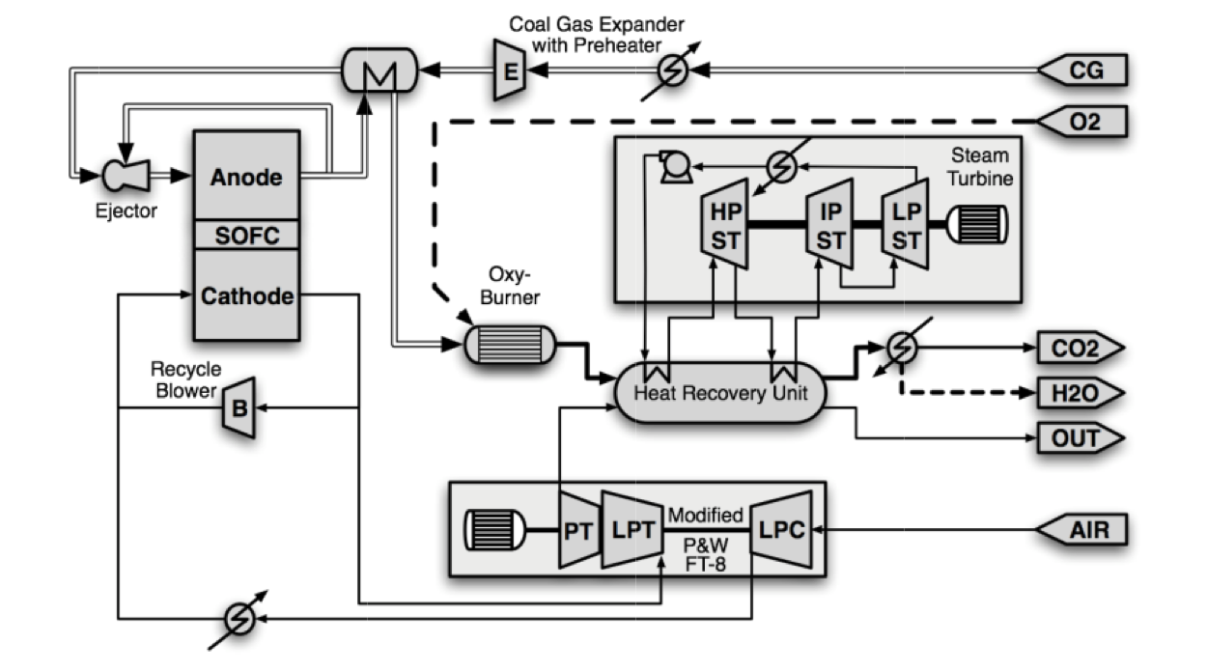
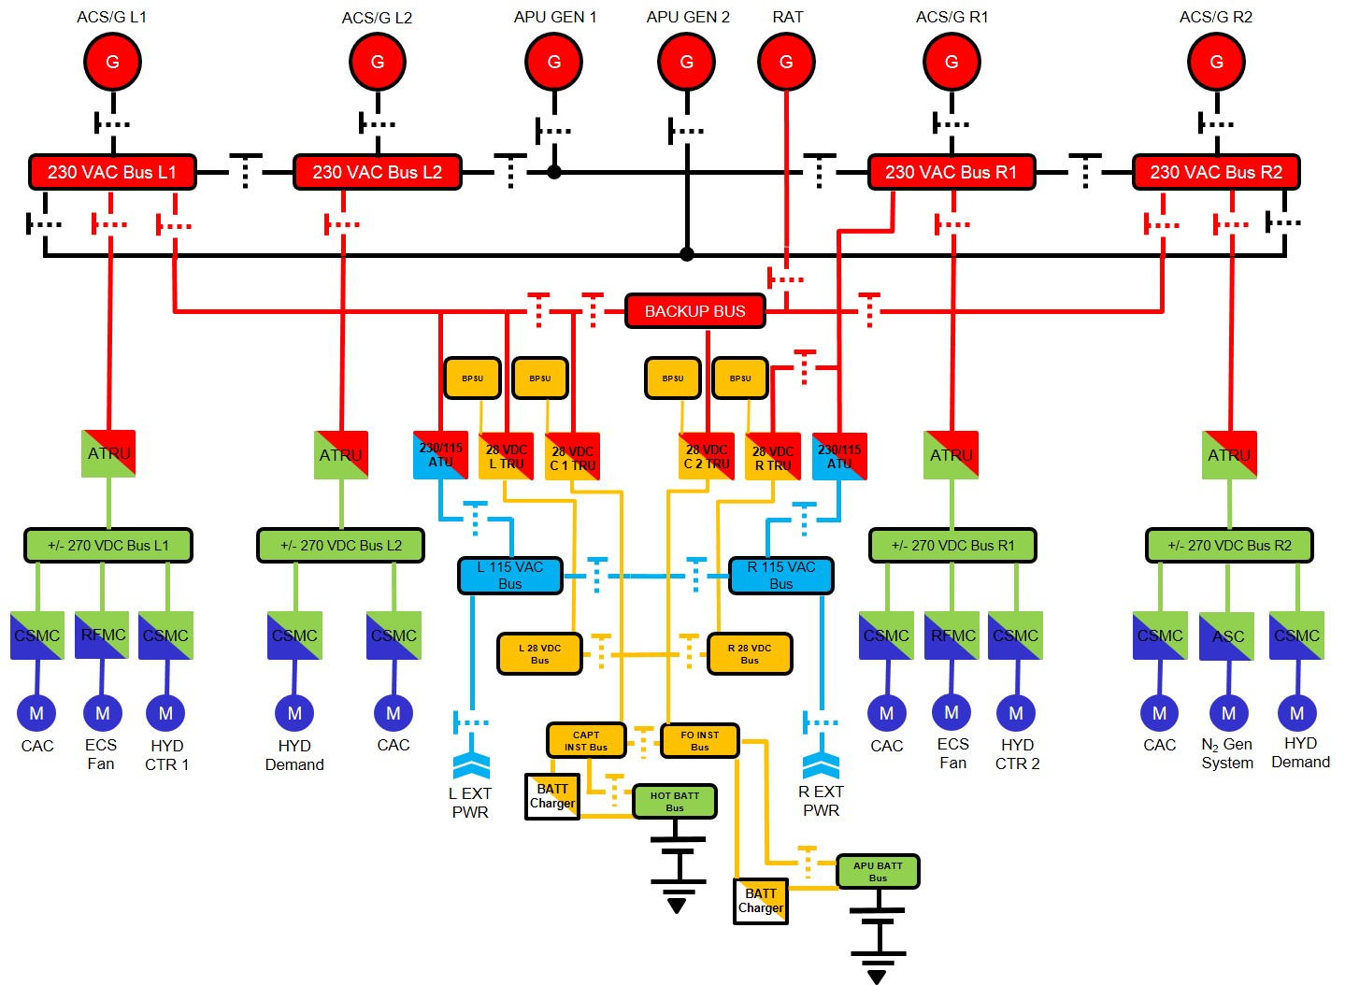
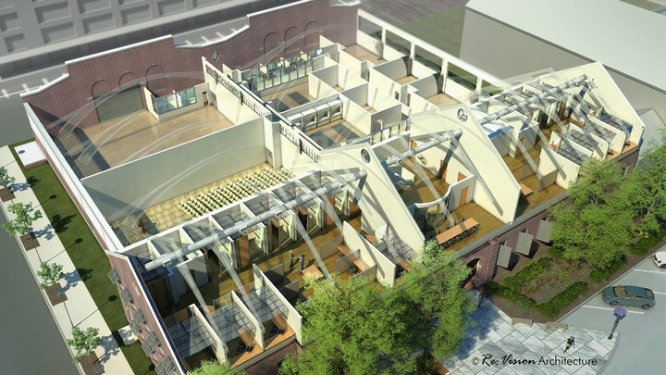
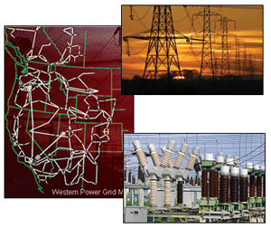
Systems Engineering Domain
Math Libraries
ExaSGD addresses systems engineering problems
Produced new direct sparse solvers using non-supernodal structures, for GPUs
Cholesky for symmetric, LU for non-symmetric
Joint effort between SuperLU, Ginkgo, ExaSGD teams
Aircraft power systems
(source: Alverstone Aviation Society)
Solid oxide fuel cell plant (source: Kameswaran at al. 2010)
Buildings (source: EEB Hub, B661 2014)
Power grids
(source: PNNL)
Gene regulatory networks (source: Peles et al. 2006)

Slide 22
Linear Solver Performance within Optimization Algorithm Average per iteration times (including first iteration on CPU)
Each GPU solution outperforms all CPU baselines
Ginkgo performance improves on a better GPU
Iterative refinement configuration affects linear solver performance and optimization solver convergence
Ginkgo provides the first portable GPU-resident sparse direct linear solver for non-supernodal systems

Slide 23

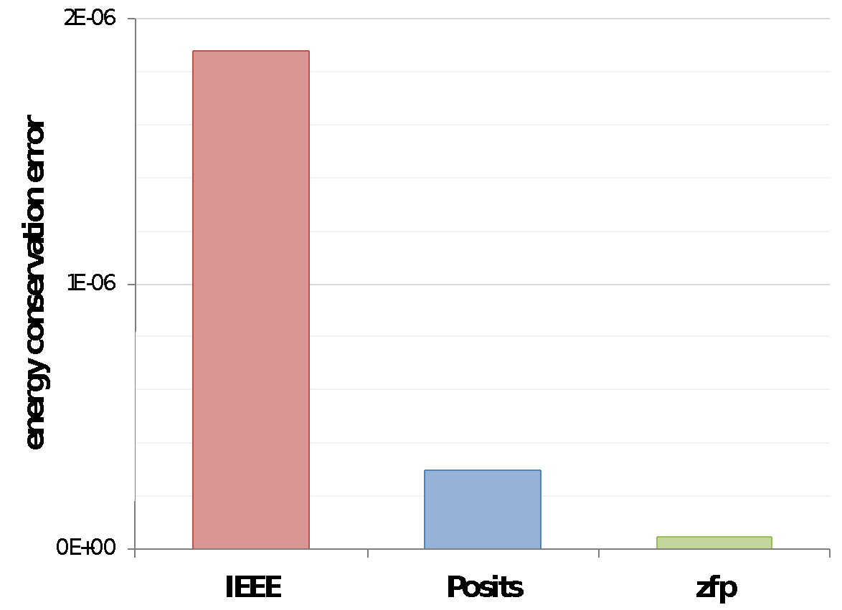
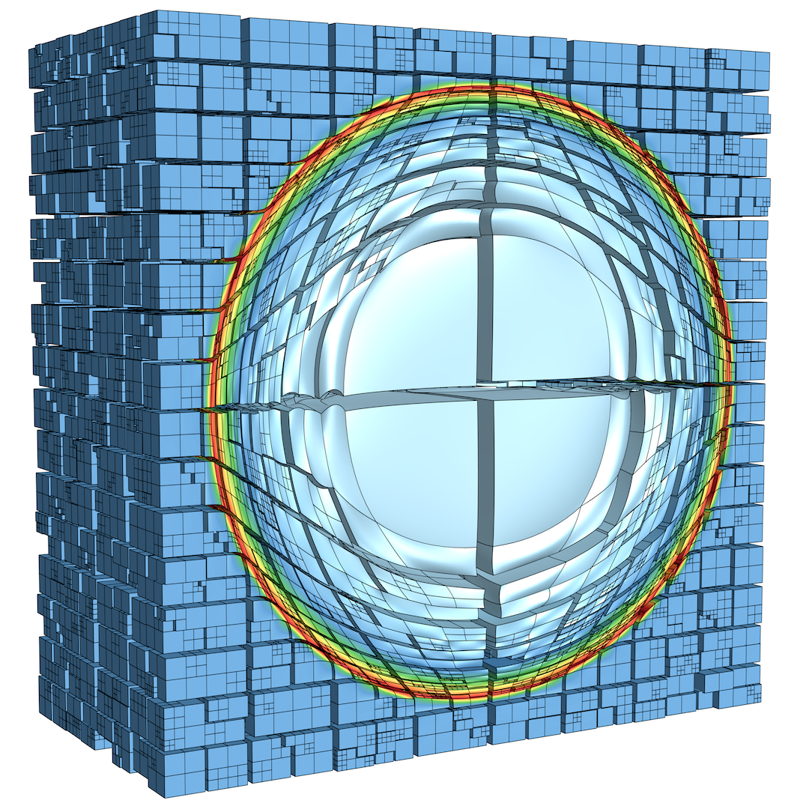

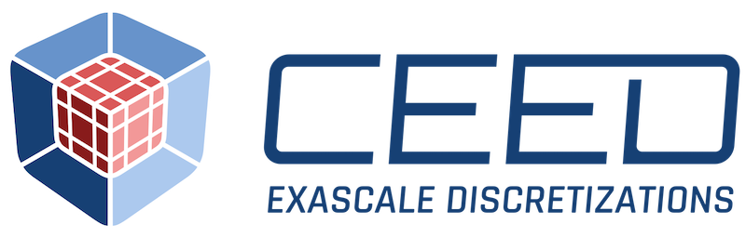




ZFP compressed multidimensional array primitive Addressing growing gap of ops vs bw vs memory
Data and Visualization
virtual array
compressed blocks
application
software cache
dirty bit
block
index
uncompressed data
Fixed-length compressed blocks enable fine-grained read & write random access
C++ compressed-array classes hide complexity of compression & caching from user
User specifies per-array storage footprint in bits/value
Absolute and relative error tolerances supported for offline storage, sequential access
Fast, hardware friendly, and parallelizable: 150 GB/s throughput on NVIDIA Volta
HPC tool support:
Inline compression boosts solution accuracy by 40x over IEEE in CEED code
Prepared by LLNL under Contract DE-AC52-07NA27344.

Slide 24
And Many More…
ECP generated a
Collection of portable GPU-capable libraries and tools for AMD, Intel, and NVIDIA devices
Designed for future adaptation to next-generation highly-concurrent node architectures
Foundation for others who will make the transition from CPU to GPU and beyond

Slide 25
ECP Software Technology works on products that apps need now and in the future
Key themes:
Focus: GPU node architectures and advanced memory & storage technologies
Create: New high-concurrency, latency tolerant algorithms
Develop: New portable (Nvidia, Intel, AMD GPUs) software product
Enable: Access and use via standard APIs
Software categories:
Next generation established products: Widely used HPC products (e.g., MPICH, OpenMPI, PETSc)
Robust emerging products: Address key new requirements (e.g., Kokkos, RAJA, Ginkgo, Spack)
New products: Enable exploration of emerging HPC requirements (e.g., Variorum, zfp)
Legacy: A stack that enables performance portable application development on leadership platforms
Example Products | Engagement
MPI – Backbone of HPC apps | Explore/develop MPICH and OpenMPI new features & standards
OpenMP/OpenACC –On-node parallelism | Explore/develop new features and standards
C++ Performance Portability Abstractions | Lightweight APIs for compile-time polymorphisms
LLVM/Vendor compilers | Injecting HPC features, testing/feedback to vendors
Perf Tools - PAPI, TAU, HPCToolkit | Explore/develop new features
Math Libraries: BLAS, sparse solvers, etc. | Scalable algorithms and software, critical enabling technologies
IO: HDF5, MPI-IO, ADIOS | Standard and next-gen IO, leveraging non-volatile storage
Viz/Data Analysis | ParaView-related product development, node concurrency

Slide 26
Spack: How we build and test our software

Slide 27
Spack automates the build of LLNL multi-physics codes
ARES is a 1, 2, and 3-D radiation hydrodynamics code
The ARES configuration shown here has 47 dependencies
ARES team runs nightly builds for 36 different configurations
4 code versions:
(C)urrent Production
(P)revious Production
(L)ite
(D)evelopment
Spack enabled testing on 3 platforms, 6 compilers, and 3 MPI implementations.

Slide 28
Spack has been ambitious about customizability from the start: “Just say what you want to install”
$ spack install mpileaks unconstrained
$ spack install mpileaks@3.3 @ custom version
$ spack install mpileaks@3.3 %gcc@4.7.3 % custom compiler
$ spack install mpileaks@3.3 %gcc@4.7.3 +threads +/- build option
$ spack install mpileaks@3.3 cppflags="-O3 –g3" set compiler flags
$ spack install mpileaks@3.3 target=cascadelake set target microarchitecture
$ spack install mpileaks@3.3 ^mpich@3.2 %gcc@4.9.3 ^ dependency constraints
DOE people never settled for the “off-the-shelf” configuration
Always want to customize library versions, build options, flags
Composition is a fundamental part of Spack’s model
Allows you to swap components like compilers, libraries, GPU runtimes, etc.
Most distributions build a much more static stack

Slide 29
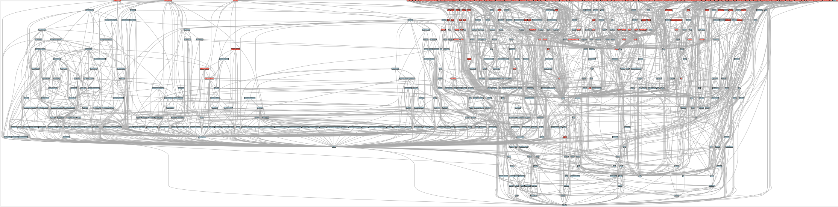
Now, the E4S stack is more than 600 packages!
Red boxes are the packages in it (about 100)
Blue boxes are what else you need to build it (about 600)
E4S sits on top of hundreds of open source community projects

Slide 30
Fall 2020
2016
2024
2023
Spring 2018
Spring 2021
Fall 2018
Fall 2021

Slide 31

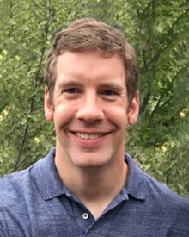
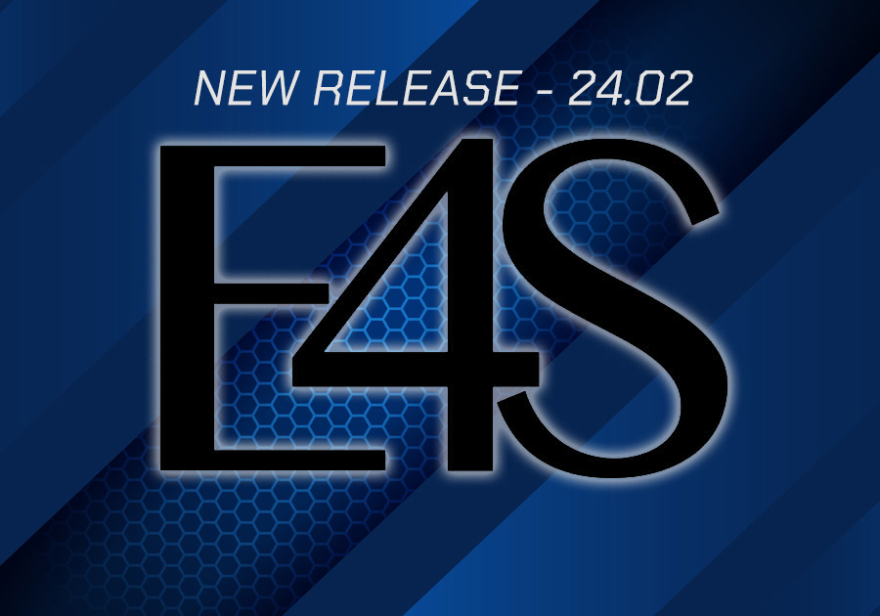

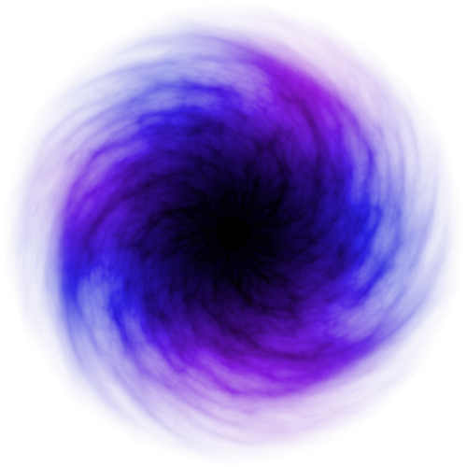

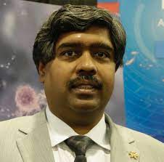




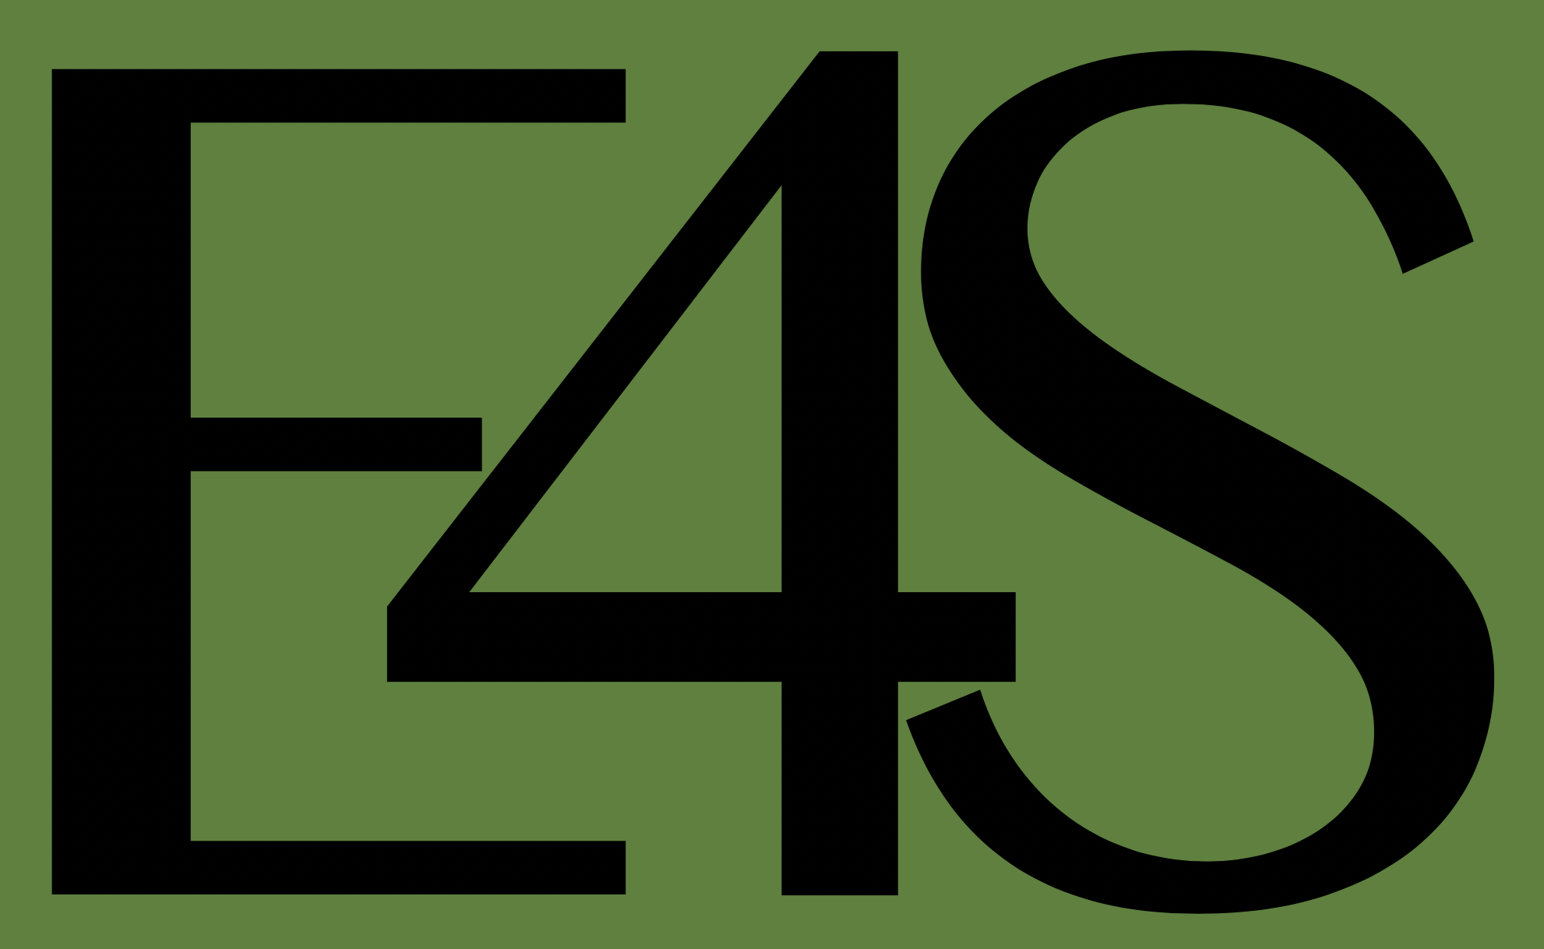

Extreme-scale Scientific Software Stack (E4S)
https://spack.io
Spack lead: Todd Gamblin (LLNL)
E4S: HPC software ecosystem – a curated software portfolio
A Spack-based distribution of software tested for interoperability and portability to multiple architectures
Available from source, containers, cloud, binary caches
Not a commercial product – an open resource for all
Growing functionality: May 2024: E4S 24.05 – 140+ full release products
One of the most important legacies of ECP
Community Policies Commitment to SW quality
DocPortal Single portal to all E4S product info
Portfolio testing Especially leadership platforms
https://e4s.io
E4S lead: Sameer Shende (U Oregon)
Curated collection The end of dependency hell
Regular releases Release 24.11 – November
Build caches 10X build time improvement
Turnkey stack A new user experience
https://e4s.io
Post-ECP Strategy PESO & CASS
Also includes other products, e.g.,
AI: PyTorch, TensorFlow, Horovod
Co-Design: AMReX, Cabana, MFEM

Slide 32
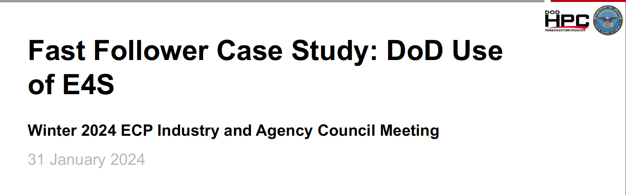
Highlights from Sean Ziegeler talk at ECP IAC Meeting
Port and use of Spack/E4S without DOE assistance
Phase 1:
Five HPC systems
3-4 compiling systems
2 MPIs
100 products + dependencies
Phase 2:
Deep dive with 16 products
Used by DoD, in E4S

Slide 33
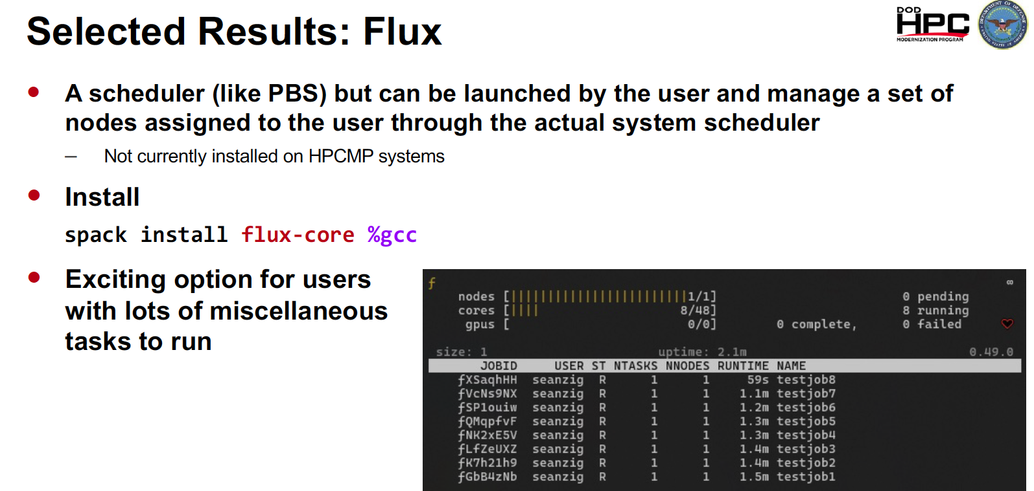
Highlights from Sean Ziegeler talk at ECP IAC Meeting
Port and use of Spack/E4S without DOE assistance
Phase 1:
Five HPC systems
3-4 compiling systems
2 MPIs
100 products + dependencies
Phase 2:
Deep dive with 16 products
Used by DoD, in E4S

Slide 34
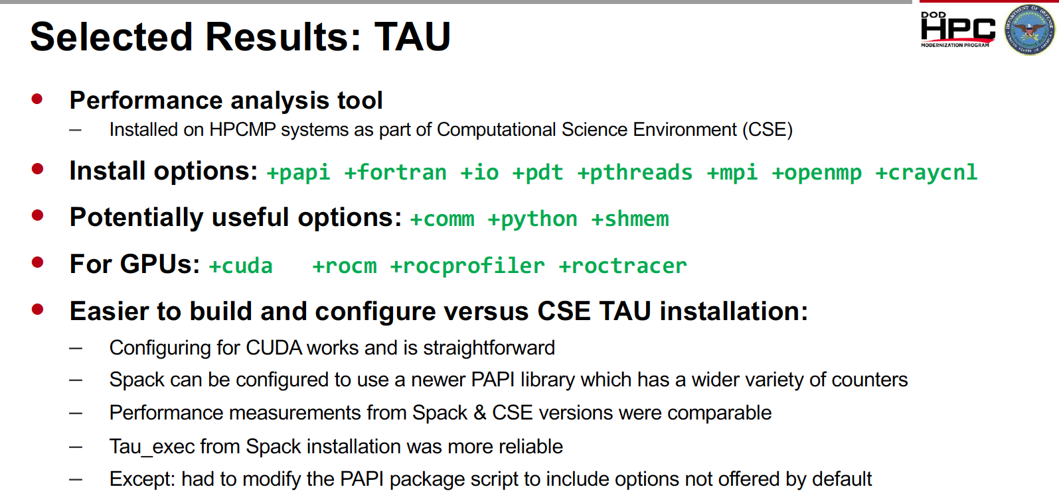
Highlights from Sean Ziegeler talk at ECP IAC Meeting
Port and use of Spack/E4S without DOE assistance
Phase 1:
Five HPC systems
3-4 compiling systems
2 MPIs
100 products + dependencies
Phase 2:
Deep dive with 16 products
Used by DoD, in E4S

Slide 35
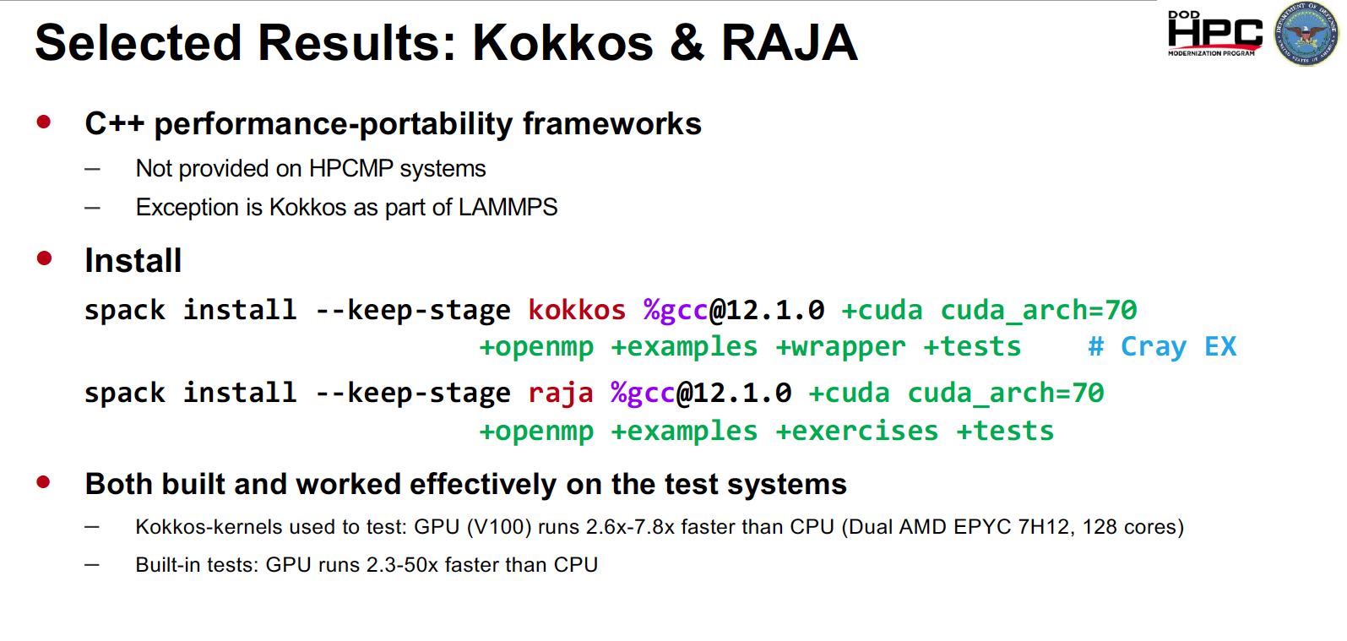
Highlights from Sean Ziegeler talk at ECP IAC Meeting
Port and use of Spack/E4S without DOE assistance
Phase 1:
Five HPC systems
3-4 compiling systems
2 MPIs
100 products + dependencies
Phase 2:
Deep dive with 16 products
Used by DoD, in E4S

Slide 36
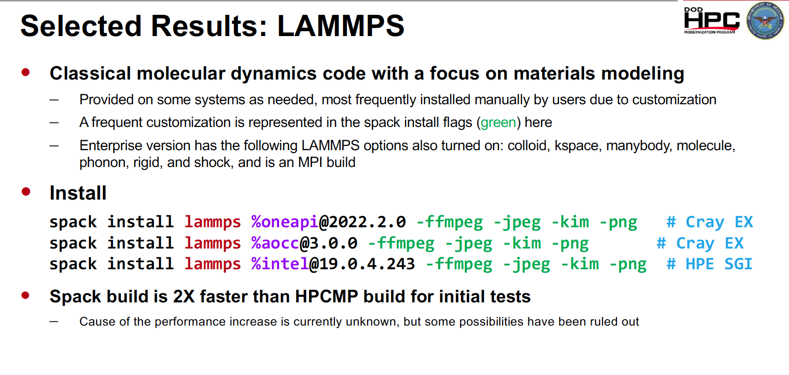
Highlights from Sean Ziegeler talk at ECP IAC Meeting
Port and use of Spack/E4S without DOE assistance
Phase 1:
Five HPC systems
3-4 compiling systems
2 MPIs
100 products + dependencies
Phase 2:
Deep dive with 16 products
Used by DoD, in E4S

Slide 37
Highlights from Sean Ziegeler talk at ECP IAC Meeting
Port and use of Spack/E4S without DOE assistance
Phase 1:
Five HPC systems
3-4 compiling systems
2 MPIs
100 products + dependencies
Phase 2:
Deep dive with 16 products
Used by DoD, in E4S

Slide 38

E4S 24.05 Release
140+ HPC-AI packages on ARM, x86_64, ppc64le platforms, 128K+ binaries in E4S build Cache
Growing suite of AI/ML packages
DeepHyper, Google.generativeai (Gemini API), OpenAI (API), TorchBraid, Pandas, Scikit-Learn, JAX, PyTorch, TensorFlow, Horovod, OpenCV, and LBANN with support for GPUs
E4S DocPortal updated with AI/ML tools
OS upgrade for containers: Ubuntu 22.04 LTS
Upgraded
CUDA from version 11 to 12,
ROCm upgraded from version 5.4 to 5.7.1.
New tools: Laghos, Glvis, netcdf-fortran, fpm, e4s-cl, and e4s-alc.
New applications: Nek5000, Nekbone, Laghos and previously supported GROMACS, CP2K, Xyce, Quantum Espresso, ExaGo, LAMMPS, WARPX, Dealii, and OpenFOAM.
Adaptive Computing’s HPC Cloud on-demand data center (ODDC) web-based platform
Multi-user, multi-node ParaTools Pro for E4S images on AWS marketplace with support for aarch64 (Graviton) as well as x86_64 with NVIDIA GPUs with
VNC based remote desktop and torque (qsub) for multi-node execution
https://adaptivecomputing.com/
CI Testing:
Frank: Extensive multi-device system
Includes Grace-Grace, Grace-Hopper
7M+ CI builds
E4S 24.11 Release – Look for SC24 announcement
Notes:
LOCAL LAB POC: Michael Heroux (maherou@sandia.gov)
TALKING POINTS:
The PESO Organizational Chart matches PESO key activities:
Partnerships: We partner with members of other SSOs to create portfolio strategy.
Services: We partner with members of other SSOs to integrate the latest products into E4S in a sustainable and robust way.
Products: We deliver & support Spack & E4S, provide porting & testing platforms leveraged across product teams to ensure code stability & portability.
METADATA:
Name of the associated awarded project:
PI name(s): Michael Heroux (Sandia), Lois Curfman McInnes (Argonne)
Name of the program manager: William Spotz, Software Stewardship and Advancement
CITATIONS:
The notes section should also include full citations (including the DOI) to any important and associated publications, datasets or code developed as part this work.
N/A
AWARDS:
N/A
REPRODUCIBILITY:
N/A.
BACKGROUND AND CONTEXT INFORMATION:
N/A

Slide 39
Looking Forward Post-ECP Software Stewardship and Advancement

Slide 40
8 Software Stewardship Organizations (SSOs) DOE Office of Advanced Scientific Computing Research (ASCR) Post-ECP Projects
PESO
Stewarding, evolving and integrating a cohesive ecosystem for DOE software
FASTMATH
Stewardship, advancement, and integration for math and ML/AI packages
SWAS
Stewardship and project support for scientific workflow software and its community
S4PST
Stewardship, advancement and engagement for programming systems
STEP
Stewardship, advancement of software tools for understanding performance and behavior
COLABS
Training, workforce development, and building the RSE community
CORSA
Partnering with foundations to provide sustainable pathways for scientific software
RAPIDS
Stewardship, advancement, and integration for data, visualization and ML/AI packages
40

Slide 41
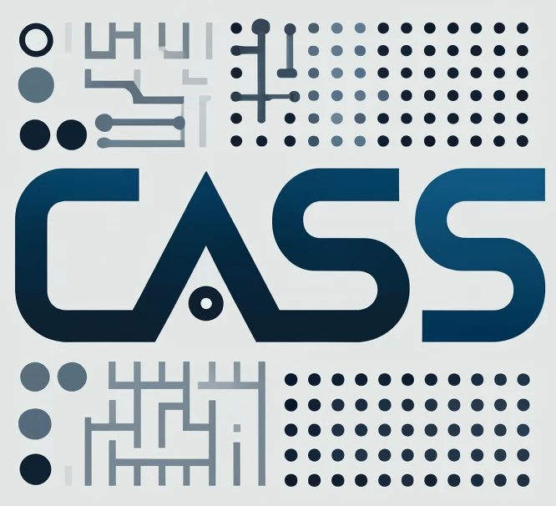
Announcing CASS The Consortium for the Advancement of Scientific Software https://cass.community
CASS Basics
A newly-formed organization
Sponsored by DOE Office of Advanced Scientific Computing Research (ASCR)
Established by DOE Software Stewardship Organizations (SSOs)
CASS Goals
Forum for SSO collaboration and coordination
Bigger than the sum of its parts
Vehicle for advancing the scientific software ecosystem
CASS Status
Defining governance structure
Establishing community awareness
Building a team of teams
Collaborating on outreach
Software Stewardship Organization (SSO) Basics
Each SSO represents a specific software ecosystem concern
Product SSOs: Programming systems, performance tools, math packages, data/viz packages
Portfolio SSO: Curating & delivering software stack to the community
Community SSOs: Workforce, partnerships
Engage with CASS
Review slides June 11-13 CASS Community BOF Days: https://cass.community/bofs
Visit https://cass.community

Slide 42
Consortium for the Advancement of Scientific Software (CASS)
CASS Formation Team
David Bernholdt
Phil Carns
Lois Curfman McInnes
Representatives of Software Stewardship Organizations (SSOs)
COLABS: Anshu Dubey, David Bernholdt
CORSA: Greg Watson, Elaine Raybourn
FASTMath: Esmond Ng, Todd Munson
PESO: Mike Heroux, Todd Gamblin
RAPIDS: Rob Ross, Lenny Oliker
S4PST: Keita Teranishi, Damian Rouson
STEP: Terry Jones, Phil Carns
SWAS: Rafael Ferreira da Silva, Lavanya Ramakrishnan
42

Slide 43













PESO: Partnering for Scientific Software Ecosystem Stewardship Opportunities
About PESO
Five-year post-ECP software-ecosystem stewardship and advancement project
Partnership with CASS
PESO leads portfolio activities of E4S+Spack curation, testing, delivery
Key PESO goals
Enable applications to realize benefits of a software ecosystem
Emphasize software product quality, the continued fostering of software product communities, and the delivery of products, working with CASS
Key PESO Activities
Partnerships: We lead CASS efforts for diverse and inclusive workforce with sustainable career paths. We shepherd BSSw Fellows Program and BSSw.io portal.
Services: We provide services including software product management, integration, and delivery, as well as software quality assurance and security.
Products: We deliver & support products via Spack & E4S, provide porting & testing platforms leveraged across product teams to ensure code stability & portability.
The PESO Project exists to preserve, sustain, and advance the investments made by the Exascale Computing Project in a robust, versatile, and portable HPC software ecosystem and the people who make the ecosystem effective.
PESO is unique in its organization by composing itself of many members of other software stewardship organizations (SSOs) to best ensure tight integration across the SSOs and support the mission of the Consortium for the Advancement of Scientific Software (CASS).
PI: Michael Heroux, Sandia National Laboratories
Collaborating Institutions: ANL, Berkeley, BNL, Kitware, LLNL, LANL, ORNL, PNNL, SNL, SHI, UO
ASCR Program: Software Stewardship and Advancement
ASCR PM: William Spotz
Resources: https://pesoproject.org, https://e4s.io, https://hpsf.io
Notes:
LOCAL LAB POC: Michael Heroux (maherou@sandia.gov)
TALKING POINTS:
PESO is a five-year post-ECP software-ecosystem stewardship and advancement project. In partnership with the Consortium for the Advancement of Scientific Software (CASS), PESO will establish and steward a sustainable scientific software ecosystem comprising libraries and tools that deliver the latest high-performance algorithms and capabilities for DOE mission-critical applications.
PESO will enable applications to realize 100X improvement in both high-end capabilities and energy efficiency by leveraging accelerator devices
PESO will emphasize software product quality, the continued fostering of software product communities, and the delivery of products, working with CASS
METADATA:
Name of the associated awarded project:
PI name(s): Michael Heroux (Sandia), Lois Curfman McInnes (Argonne)
Name of the program manager: William Spotz, Software Stewardship and Advancement
CITATIONS:
The notes section should also include full citations (including the DOI) to any important and associated publications, datasets or code developed as part this work.
N/A
AWARDS:
N/A
REPRODUCIBILITY:
N/A.
BACKGROUND AND CONTEXT INFORMATION:
N/A

Slide 44


PESO: Partnering for Scientific Software Ecosystem Stewardship Opportunities
Long build times
Out-of-date algorithms
Awareness of latest SW practices
Opportunities to improve your software
https://pesoproject.org
Are these challenges familiar? Investing in the Spack/E4S ecosystem can help
Installing 3rd party libs and tools
Managing library version updates
Adopting new libraries and tools
Managing portability across CPUs/GPUs
Spack and E4S
“Powers of 10”
possibilities
100,000+
Lines of code replaced with high-quality libs & tools
Using robust open-source libraries and tools helps you eliminate native source code that is less capable, more fragile, and harder to maintain
100+
Speedup using advanced devices like GPUs
ECP-sponsored applications realize a factor of 100 or more science-speedup by reformulating algorithms and software to exploit GPUs
10,000+
Community members via ecosystem collaborations
Shared experiences using the same ecosystem increases community knowledge base, improved software capabilities, cross-teaming
10+
Reduction in build times via Spack build caches
Spack build caches reduce re-build times by a factor of 10 or more, greatly reducing staff wait times and accelerating debugging and reconfiguration activities
1,000+
Code teams share ecosystem costs & benefits
Pooling investments and making the software ecosystem available everywhere optimizes cost and benefit sharing across many users
1
Source code base for all computing systems
Your single source code base that achieves performance portability, now and in the future, using libraries, tools, and compilers available via Spack and E4S
Engage with PESO
Notes:
Notes: Can choose to use either Preliminary Results or Key Achievements depending on stage of the project.

Slide 45
The High-Performance Software Foundation

Slide 46
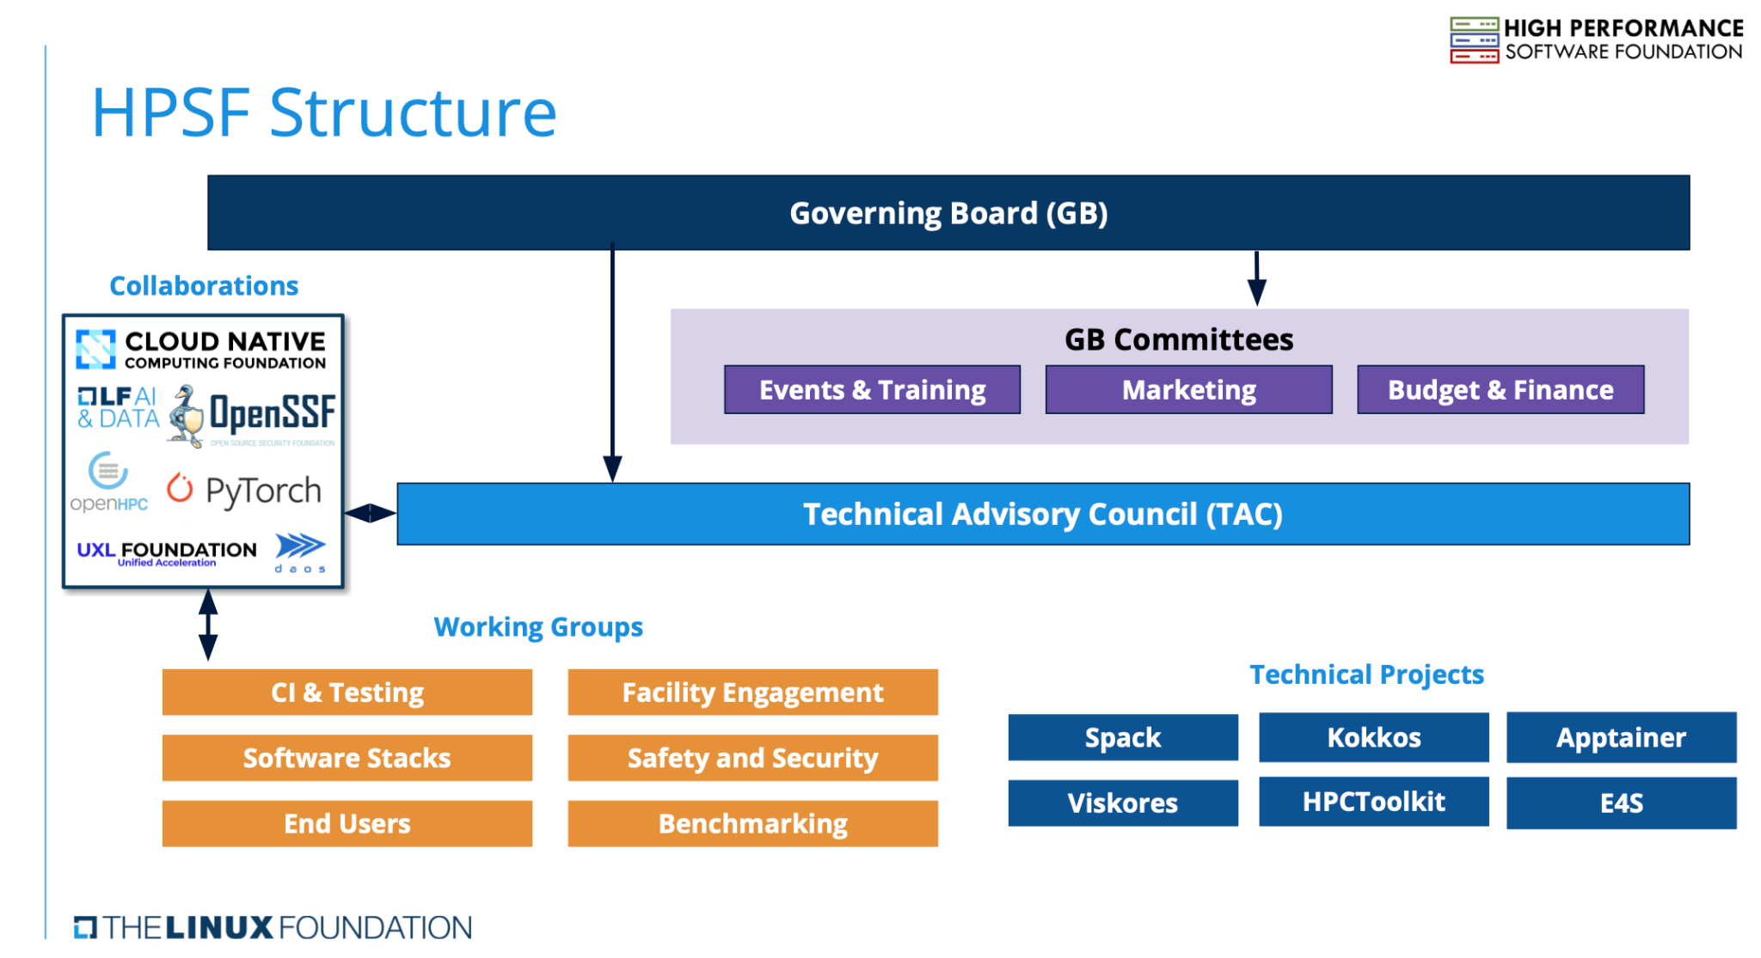

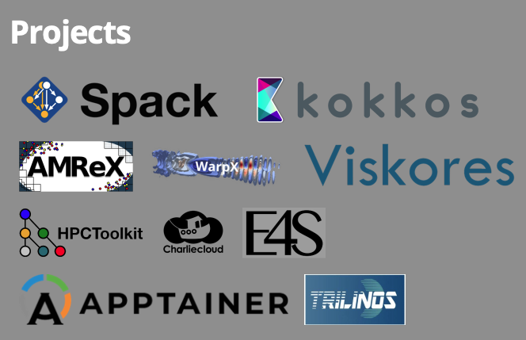










We launched the High Performance Software Foundation (HPSF) at ISC24
Scientific Achievements
NNSA led the formation of HPSF over the past 18 months, in close collaboration with DOE/ASCR, industry, and the Linux Foundation
15 founding members, 6 initial projects from industry, academia, labs around the world
HPSF provides open source projects with:
A neutral home
Funds for project infrastructure, working groups, events, other initiatives
Collaborations
Open governance
Premier Members
Significance and Impact
Initial membership raised more funds than expected: ~$1M annual budget
ISC kickoff BOF session was standing-room only; generating much excitement
Expect to grow membership and projects over time
2 NNSA, 2 ASCR, 2 European projects in the pipeline
Expecting at least 2 more general members within the year
General Members
Approach
Separate financial (GB), technical (TAC), and project governance
Interact directly with key projects in the HPC ecosystem
Grow contributor base through increased adoption, training, events, outreach
Build a portable, accelerated software stack for HPC and beyond
Associate Members
PI(s)/Facility Lead(s): Todd Gamblin, Christian Trott
Collaborating Institutions: NNSA/ASC, PESO, CORSA, Linux Foundation
DOE Programs: NNSA/ASC, ASCR/NGSST
DOE PMs: Si Hammond, William Spotz, David Rabson, Hal Finkel
Resources: https://hpsf.io
Notes:
LOCAL LAB POC: Todd Gamblin <gamblin2@llnl.gov>
TALKING POINTS:
METADATA:
Name of the associated projects: NNSA/ASC, with participation from PESO, CORSA
PI name(s): Todd Gamblin (LLNL), and Christian Trott (SNL), (ASC); Mike Heroux (SNL, PESO), Greg Watson (ORNL, CORSA)
Name of the program managers: Si Hammond (ASC), William Spotz (PESO), David Rabson (CORSA)
RESOURCES:
https://hpsf.io
AWARDS:
N/A
REPRODUCIBILITY:
N/A.
BACKGROUND AND CONTEXT INFORMATION:
N/A

Slide 47
Some opportunities going forward
The growing success of generative AI is spurring disruptive changes in scientific software
GPUs are really AI devices (CPUs are still relevant and can benefit from concurrency too)
A recent Hyperion survey estimates the high-end AI market is 30 times larger than traditional HPC
Bad news: We are no longer a strong market driver
Good news: The HPC market is still large but the AI market is huge. We can benefit greatly, if we want …
Here are three ways to benefit:
New algorithms adapted to AI devices New computing devices, such as GPUs designed for AI workflows, are suitable for traditional scientific codes but require extensive algorithm and software changes to realize their potential.
AI models to complement or replace analytic models AI inference engines are compelling components, complementing or replacing traditional modeling and simulation approaches.
Leverage AI tools in our research work Generative AI tools are transforming the entire research enterprise, especially software activities. AI tools assist in producing requirements, specifications, designs, source code, tests, and more. These changes are exciting but come with risks.

Slide 48
Summary
The Exascale Computing Project (ECP):
Explored many approaches to performance-portable accelerator-based computing
Focused on very high end but most innovations were on the node: suitable for desktop on up
De-risked the path for many others: 62 applications from many domains showed a path forward
In addition to transforming your own software base, you could consider using ECP-developed products:
Kokkos, zfp, Spack are a few
E4S provides many others
HPSF-sponsored products are also emerging
PESO, CASS, and other software stewardship projects are evolving to meet future needs
Happy to talk further: mheroux@acm.org

Slide 49
Post-ECP and Final Remarks
DOE/ECP has learned a lot about producing software contributions to the HPC community:
Improved planning, executing, tracking, assessing, integrating, and delivering
Improved interactions with the broader HPC software and hardware community
Direct engagement with industry, US agencies, and international collaborators
In post-ECP efforts we propose to continue and expand these efforts:
Further engage with commercial partners to provide a rich, robust software ecosystem
Evolve a stable, sustainable business model for engaging with agencies and industry
Engage with cloud providers, software foundations, and others to optimize cost & benefit sharing
Further the ECP strategy for direct industry and agency engagement
We intend to realize the potential of the ECP legacy across the HPC community:
Realize the potential of software ecosystems by leveraging “powers of 10” advantages
Increase the trustworthiness, sustainability, and cost effectiveness of our software in the future
Support existing and emerging needs for AI/ML libraries and tools
We want to work with the HPC community to realize the legacy of ECP, and beyond
We have many new ways to interact
Many new opportunities to pursue
Thank you!

